Slide 1

Year 1 Reading and Phonics Workshop

Slide 2
Aims
What is Phonics?
What Phonics Scheme Do We Use?
How do we develop comprehension ?
How can you support your child at home?
Phonics and Reading at Knaphill Lower School – Year One

Slide 3
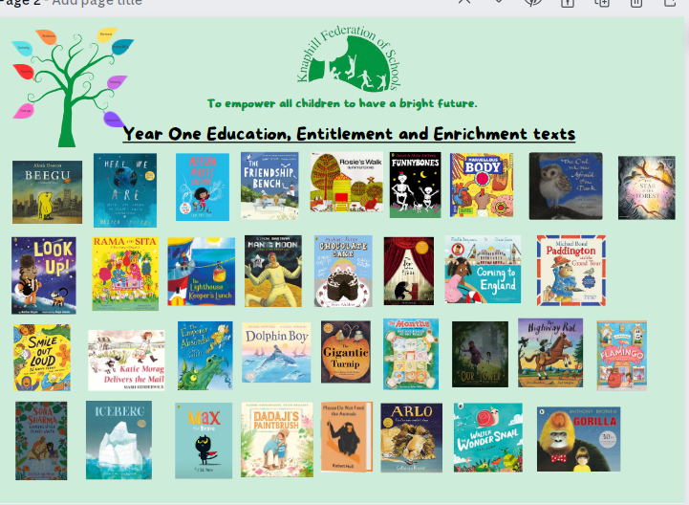
At Knaphill Lower School….
“ Reading is given the highest priority. The school describes this as a ‘gateway’ skill, since being able to read helps pupils to access other areas of the curriculum. Staff support pupils to learn to read quickly. This begins as soon as children start in the early years. Teachers expertly check that pupils have learned the intended sounds.
Some pupils need more help to keep up with their peers. This is provided quickly and effectively.
Pupils love to read books as well as listening to their teachers read to them. Books are a strong feature throughout the school and staff have carefully considered what books are available to pupils.
There is a clear focus on pupils being able to see themselves in the books that they read while developing cultural and moral awareness.” Ofsted, 2024
Notes:
“Early reading is given high priority as it is vital for children’s success. We know that reading is key to enabling children to access learning across the curriculum as it allows children to acquire knowledge and to build on what they already know. At Knaphill Lower School, our carefully-selected, DfE approved phonics scheme is Essential Letters and Sounds through which children experience the joy of books and language whilst rapidly acquiring the skills needed to become fluent, confident and independent readers and writers. Our curriculum celebrates literature by giving every child access to the rich variety of texts that they are entitled to experience, and inspires children to develop a lifelong love of reading”

Slide 4
Reading in Year One
Daily Phonics Sessions
Daily reading in School using Apply Booklets and reading decodable texts during paired reading.
Regular Assessment for Learning
Keep up sessions to address any gaps in knowledge
Daily Story Sessions – To Develop Comprehension skills.
Parental Support with reading at home
Notes:
Daily Phonic Session
Opportunity to apply their reading using special apply booklets and decodable texts
Teachers assess the children regularly to ensure that the children are not developing gaps. We aim to support the children keeping up not catch up.
Daily story sessions using carefully chosen text support the children in developing vocabulary, listening and comprehension skills.
your support is crucial and reading to or reading with your child with have a significant impact on their progress.

Slide 5
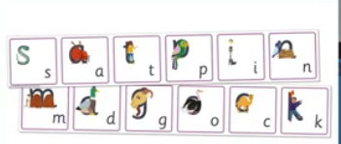
What is Phonics?
A method of teaching beginners to read and pronounce words by learning to associate letters or letter groups with the sounds they represent.
There are 44 main sounds in the English Language. Each sound is represented by a grapheme (the written representation of a sound)

Slide 6
Phoneme: the smallest single identifiable sound in a word. For example,in the word 'cat' there are three phonemes c/a/t.
Grapheme: the written representation of a sound.
Digraph: two letters making one sound. For example, /sh/ in the word 'shop'.
Trigraph: three letters making one sound. For example, /igh/ in the word 'night'.
Split digraph: two vowel letters but are split by one or more consonants. For example, /a-e/ in the word 'cake'.

Slide 7

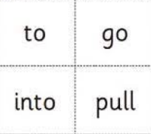
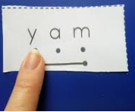


Some other terms you might hear….
“Robot Talk”
Harder to read and spell words
Blending
Segmenting
Notes:
“Robot Talk” This is a term and strategy we use to support children when orally segmenting and blending words.
We teach harder to read words by encouraging children to identify the part of the word that is “tricking us” this knowledge then helps them to read other irregular words that follow the same pattern. We practise reading harder to read and spell words everyday to encourage
Blending

Slide 8
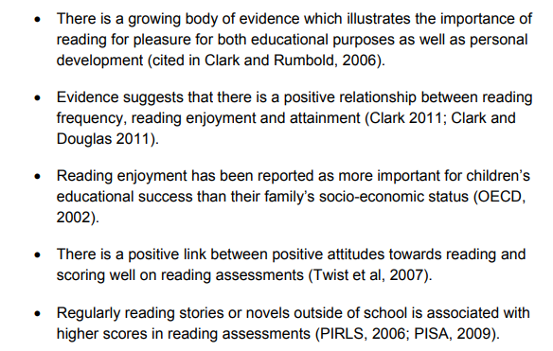
What does the Research tell us.

Slide 9
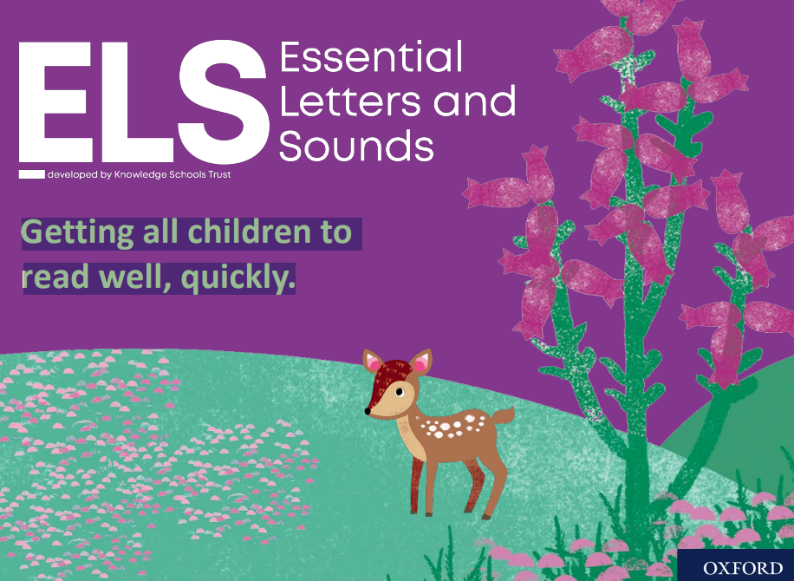
Notes:
Essential Letters and Sounds (ELS) is our chosen phonics programme. It teaches children to read by identifying the phonemes (smallest unit of sound) and graphemes (written version of the sound) within words and using these to read words. Children experience the joy of books and language whilst rapidly acquiring the skills they need to become fluent independent readers and writers.

Slide 10


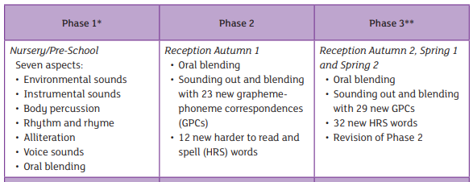
ELS Progression
© Oxford University Press 2021
Notes:
In Reception your children will learn all the single letter sounds and begin to learn diagraphs and trigraphs.

Slide 11
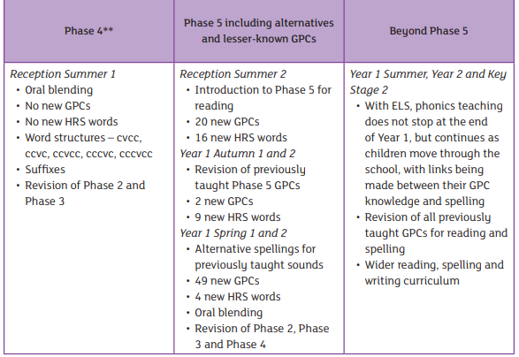
ELS Progression
© Oxford University Press 2021

Slide 12
Alternatives
For instance, in the words Autumn and Saw, the phonemes 'au' and 'aw' create the same sound, although they are spelt differently.
The same is true of the words Storm and Wall. In this example, the phonemes 'or' and 'al' create the same phonic sound.
© Oxford University Press 2021

Slide 13
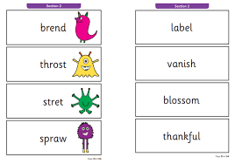
Phonics Screening Check – Summer Term Year One
The phonics screening check is a check of your child’s phonics knowledge. It helps your school confirm whether your child is making the progress expected in the national curriculum.
The phonics screening check contains 40 words divided into two sections of 20 words. Both sections contain a mixture of real words and pseudo-words.
Pseduo-words are words that are phonically decodable but are not actual words with an associated meaning.
Pseudo-words are included in the check specifically to assess whether your child can decode a word using their phonics skills.
Notes:
Looking aheThe phonics screening check contains 40 words divided into two sections of 20 words. Both sections contain a mixture of real words and pseudo-words.
Pseduo-words are words that are phonically decodable but are not actual words with an associated meaning.
Pseudo-words are included in the check specifically to assess whether your child can decode a word using their phonics skills.
All pseudo-words in the check are accompanied by a picture of an imaginary creature. Children are taught that when a word has a creature next to it, it is a pseudo-word. This is to ensure that they are not trying to match the pseudo-word to a word in their vocabulary.
The check is designed to give teachers information on how your child is progressing in phonics. It will help to identify whether your child needs additional support at this stage so that they do not fall behind in this vital early reading skill.
ad to the end of the reception year. These are the

Slide 14
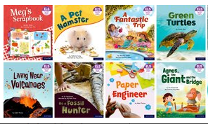
Reading Books
Children are assessed regularly so that teachers can match their current level of understanding to the appropriate book
Children keep the same book throughout the week to ensure fluency, prosody and comprehension skills.
Children should be able to read the book with 90% fluency. This encourages confidence alongside wider reading skills.
In most texts on the inside front or back cover there are ideas of ways you can support your children .
Notes:
Your child will be given a book that matches their phonic ability. Please could we ask that you support your child by listening to them read their book at least 4 times.
Reading their book 4 times across the week working on these skills: decode fluency expression
We want children to create a strong orthographic map.
This means that they learn sounds spelt by the letters or groups of letters in each word.
To read fluently, or well, we need a strong orthographic map.
To consistently recognise that ea in bead spell /ee/ we need to read it at least 4 times. This means we need to read the word many time to build fluency for reading.

Slide 15
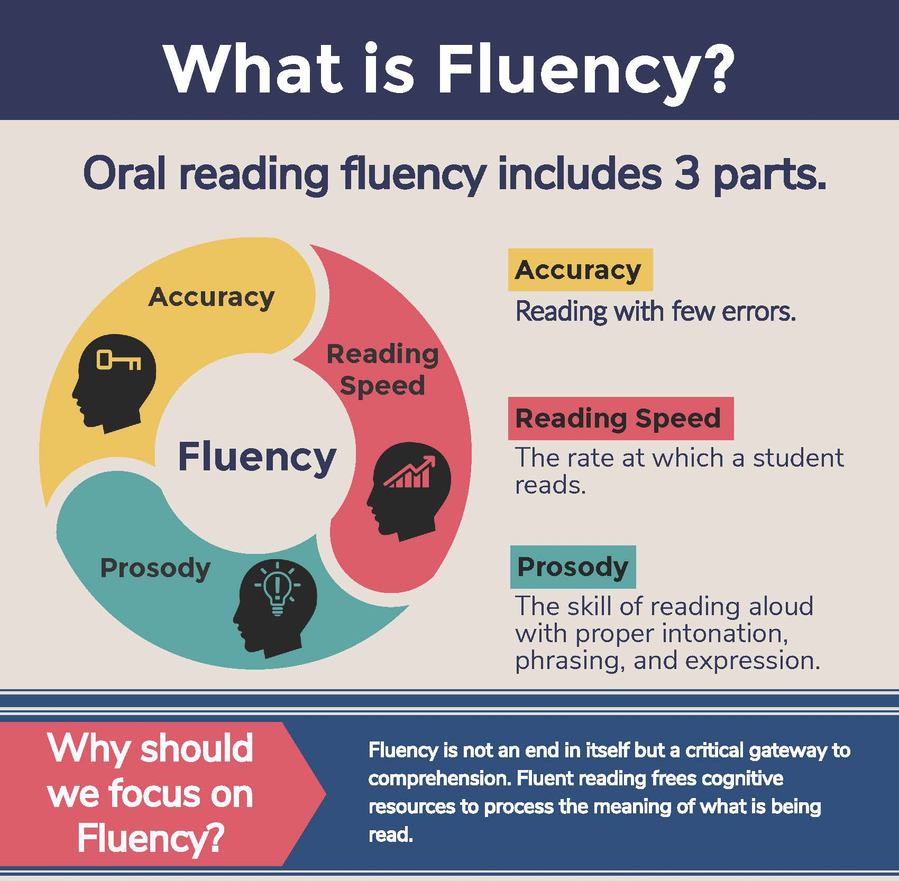
What is fluency and why is it important?
Fluent reading supports reading comprehension. When pupils read fluently, their cognitive resources can be redirected from focusing on decoding and onto comprehending the text. For this reason, fluency is sometimes described as a bridge from word recognition to comprehension.
Basically, if the brain’s processing power isn’t being used up by working out how to read a word, it can concentrate on understanding and enjoying the text.

Slide 16
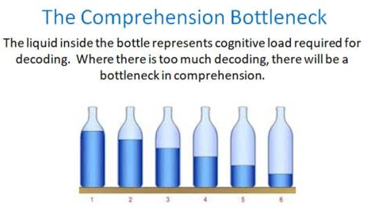
What is fluency and why is it important?
For a child to be fluent, phonic knowledge is important.
When a child is fluent, we can focus on understanding and comprehension.
When comprehension is secure, the child will enjoy what they read.
Secure phonics and fluency all reduce cognitive load.

Slide 17
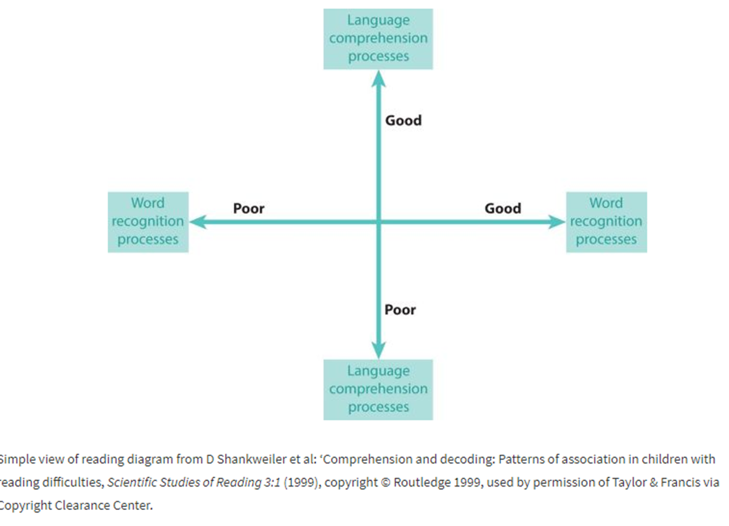
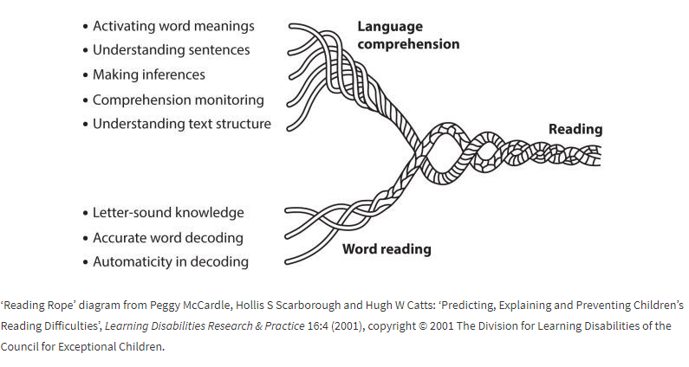
Reading Comprehension
Notes:
Skilled reading depends on both word reading and language comprehension, as the ‘Reading Rope’ diagram by psychologist and literacy expert Hollis Scarborough illustrates
Scarborough makes it clear that both knowledge and skills support the development of word reading accuracy and comprehension. To be successful in understanding what they read (that is, to comprehend it), children need to develop accurate and automatic word reading skills as well as purposeful and accurate text processing strategies in order to extract meaning.
This refers to the understanding of a text.
There are cases of where children are able to read thanks to secure phonics knowledge and the ability to decode but do not understand what they have read.

Slide 18
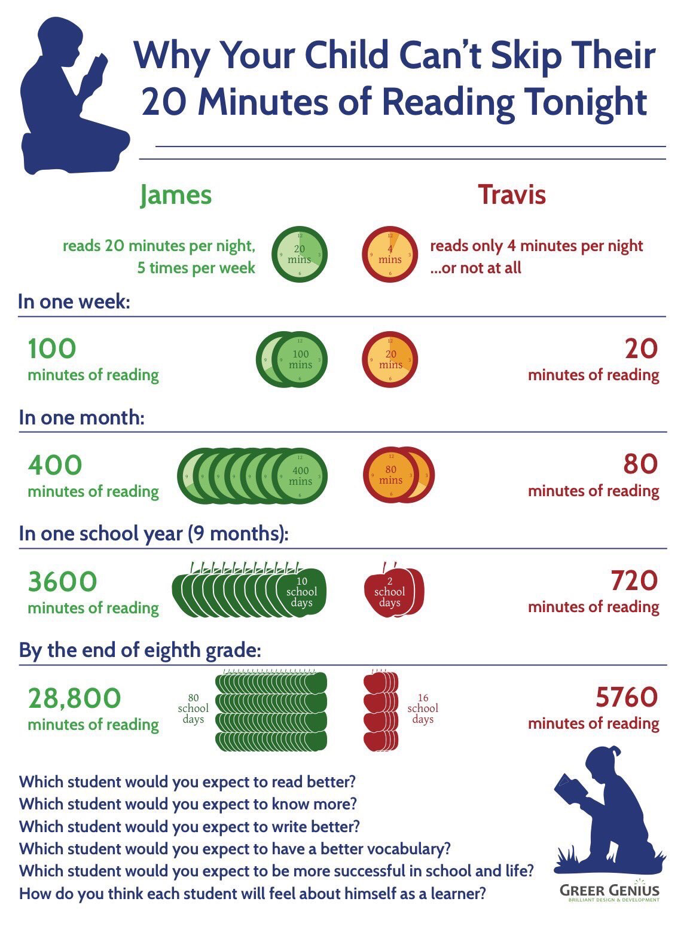
How can you support your child at home?
https://youtu.be/sKFdKs_2wJY
Notes:
sOral language development is key to children’s development. Language development can be enhanced by the amount of spoken language a child hears and joins in with. Language comprehension is an important pre-requisite to children being able to understand what they read for themselves, when the teaching of phonics begins in reception. It’s also important to later success with writing composition.
Language development links closely to listening and understanding. Introducing children to a wide range of words they would rarely hear or use increases their knowledge of vocabulary and concepts to help them understand the world around them. Hearing and talking about these words in context helps children to understand. Research has show that children who are read at lea
Through reading with children you talk about the meanings of words. This starts with you providing and talking about the children’s interests and gradually extending their knowledge about the world around them.
Listening to stories introduces children to words they would not often hear in everyday speech. It also gives them an awareness of sentence structure.
a wide range of reading experiences to help children develop a love of reading, curiosity and wonder about the world around them. Providing a well sequenced reading curriculum to develop children’s knowledge of language and how it works, can create fluent, passionate and lifelong readers.

Slide 19
Importance of Pronunciation
We must use pure sounds when we are pronouncing the sounds and supporting children in reading words. If we mispronounce these sounds we will make reading harder for our children.
https://www.yout-ube.com/watch?v=nBFnAcXHOUQ
Notes:
There are some sounds that are commonly pronounced in correctly with “uh” sound for example m –uh or s-uh
This can have a negative impact on children being able to blend words when reading or segment words when writing.

Slide 20
Three ways you can help build fluency at home…
Read and follow – the adult reads the text and the child follows along with their finger. This helps the child with word recognition and models to them how they should read with fluency.
My turn, your turn – take turns reading a page or a paragraph. Here you are modelling how to read with fluency, flow and expression.
Echo Reading – as you read, the child copies. It is important here to pace yourself and read at a rate that your child can keep up with.

Slide 21
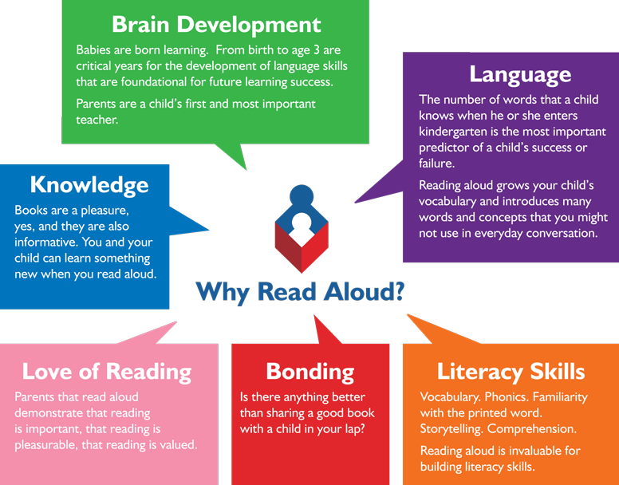
Reading from an early age and securing phonics
Reading from an early age is important as research shows that if children are not secure and fluent readers by Year 2, it is very difficult to then develop a love of reading going forward.
In order to get children fluent in reading, their phonic knowledge must be embedded within EYFS and KS1.
Read to children from day zero!

Slide 22
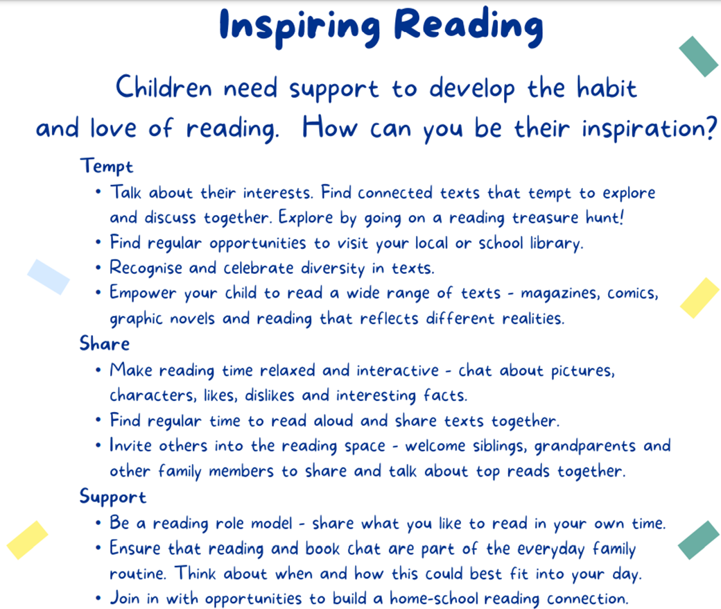

Slide 23


https://home.oxfordowl.co.uk/reading/reading-schemes-oxford-levels/essential-letters-and-sounds/

Slide 24
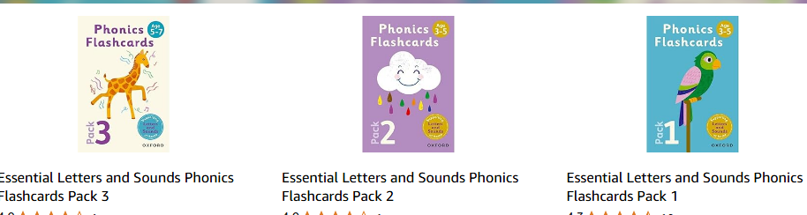

Resources to support learning at home.

Slide 25
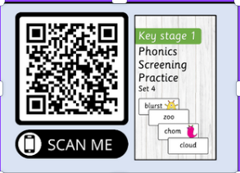
Welcome the V.I.Rs
(The Very Important Readers)
Phonics Lesson
Apply Activity
Real Word? Alien Word?
Story Time

